Slide 1
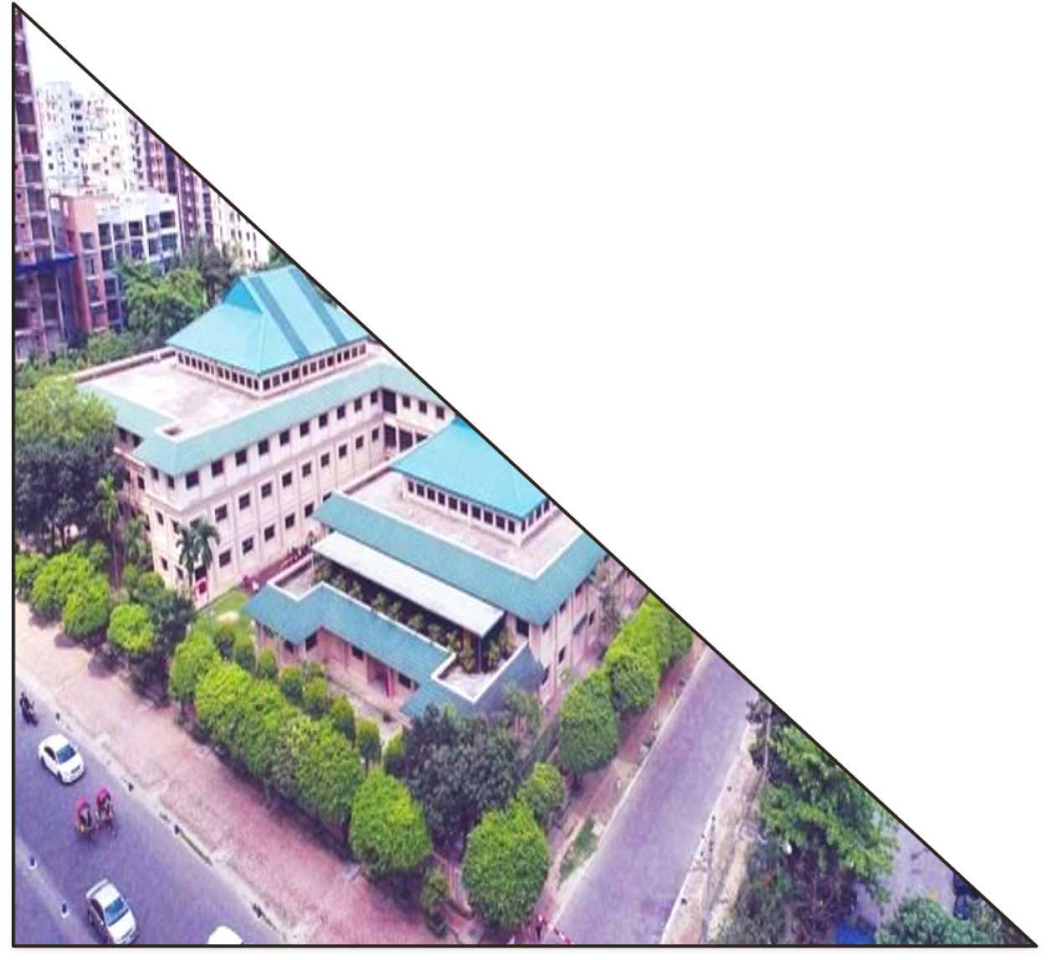

Bashundhara
Group Bangladesh

Slide 2

Presented By:
Israt Marin Kakon
Department: Management Studies
Batch: 69

Slide 3
Bashundhara Group Overview
Founded in 1987, one of Bangladesh's largest industrial conglomerates
Core industries: real estate, paper, cement, steel, and more.
Vision: To lead in every sector they operate
Mission: Driving economic growth and quality lifestyle for Bangladesh.

Slide 4




Key Products
Bashundhara Paper: Exporting eco-friendly paper products worldwide.
Bashundhara LP Gas: Reliable and safe energy solutions.
Bashundhara Food & Beverage: Diverse range of high-quality food products.
Bashundhara Cement: One of the largest cement producers in Bangladesh.

Slide 5
Sales and Cost Statistics
Year | Revenue (BDT in Million) | Cost of Goods Sold (BDT) | Profit (BDT)
2022 | 500 | 350 | 150
2023 | 550 | 375 | 175

Slide 6
Financial Performance Overview (2022-2023)

Slide 7
Corporate Social Responsibility (CSR)
Education: Scholarships for underprivileged students.
Environment: Eco-friendly manufacturing and green initiatives.
Disaster Relief: Donating supplies during natural calamities.
Sports Sponsorships: Supporting cricket and football in Bangladesh.

Slide 8

Bashundhara LP Gas Documentary vedio

Slide 9
Mision
Vision
Bashundhara Group believes in serving the people and the country; not only in doing business and making profit. It had come into existence with that belief and adopted. For the People, for the Country as its care them.The Group has reached out to many poor and underprivileged people through different philanthropic services and it wants to expand them across the country for the welfare of the people and development of the country.
Bashundhara Group has already become one of the largest conglomerates and the leader in many areas of business and industry in Bangladesh. It wishes to go far ahead from where it is now. The group wants to be the country's largest business house and the biggest contributor, from the private sector to the economics and social development. It also wishes to bring more and more people under the job and thus become the largest employer in the private sector.

Slide 10
Conclusion
Bashundhara Group is a diversified leader contributing significantly to Bangladesh’s economy.
Visionary leadership and innovative strategies are driving growth.

Slide 11
Thank You
Contact Info:
Email: info@bashundharagroup.com
Website: bashundharagroup.com
Phone: +880 1576508914

